Slide 1
Ascension Technology
C.A.R.
Matthew Darby, Maggie Burton, Weston Straw, Mark Du, Andrew Case, Stevie Damrel

Slide 2
Website
https://baylorsailor.github.io/C.A.R./site

Slide 3
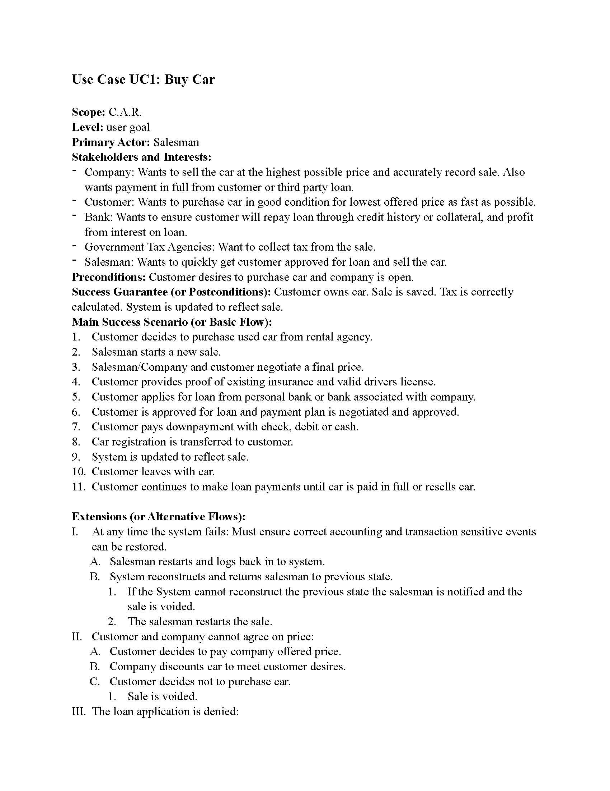
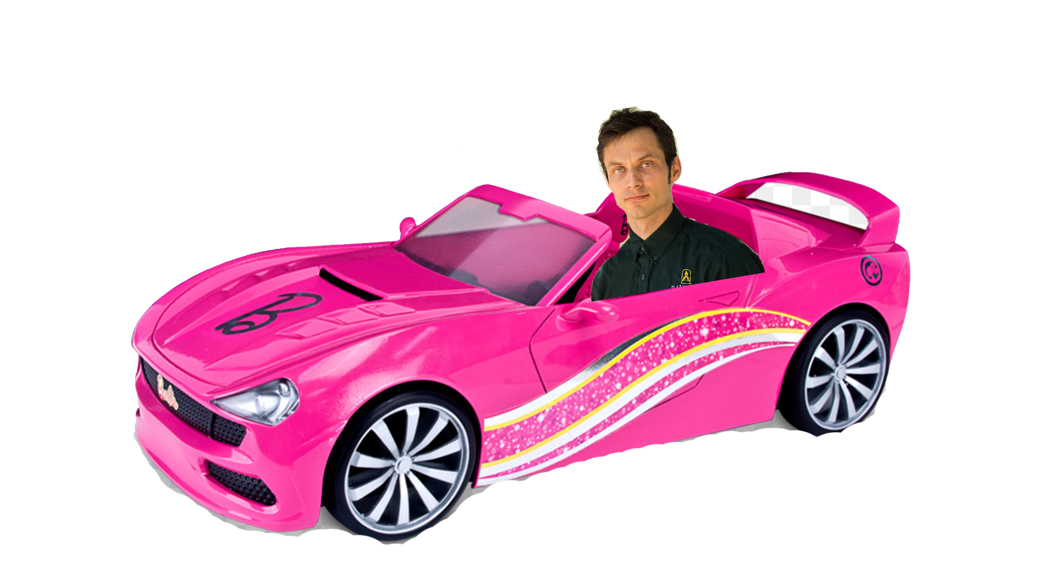

Slide 4
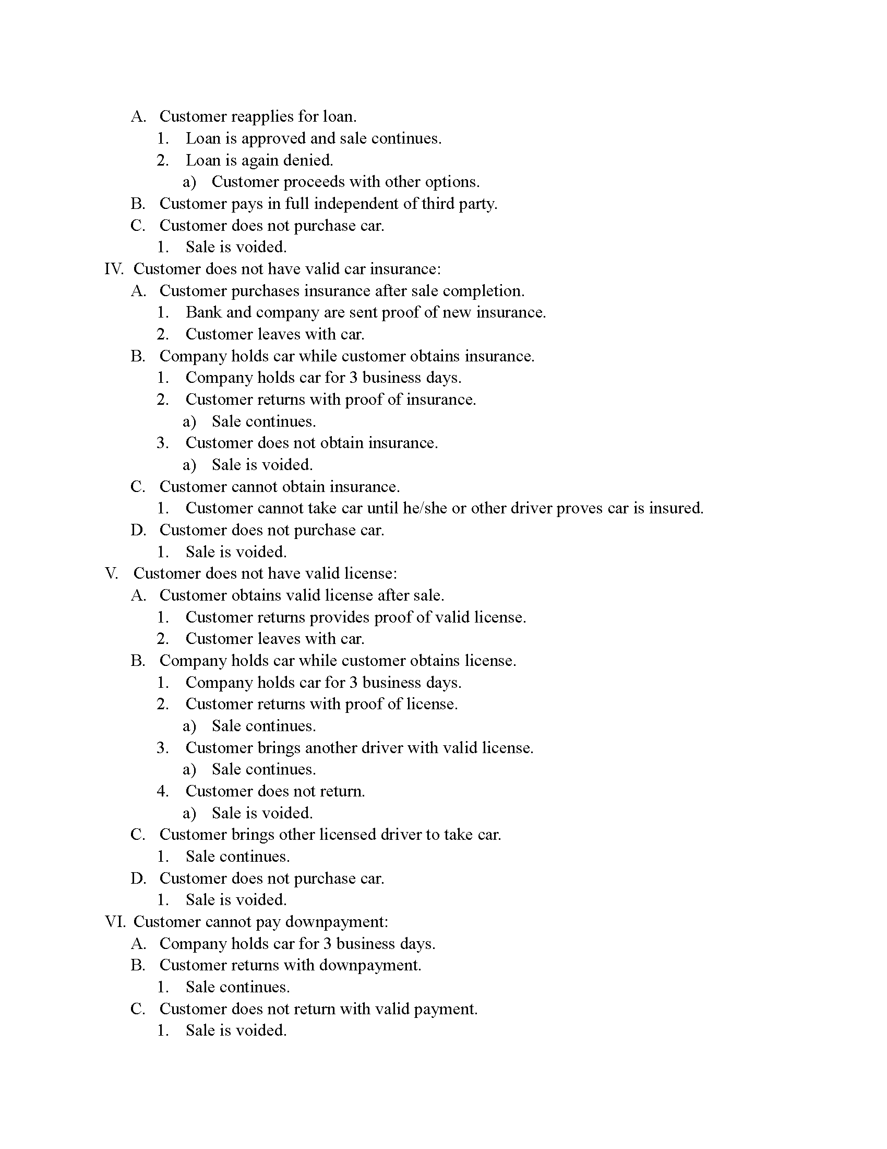


Slide 5
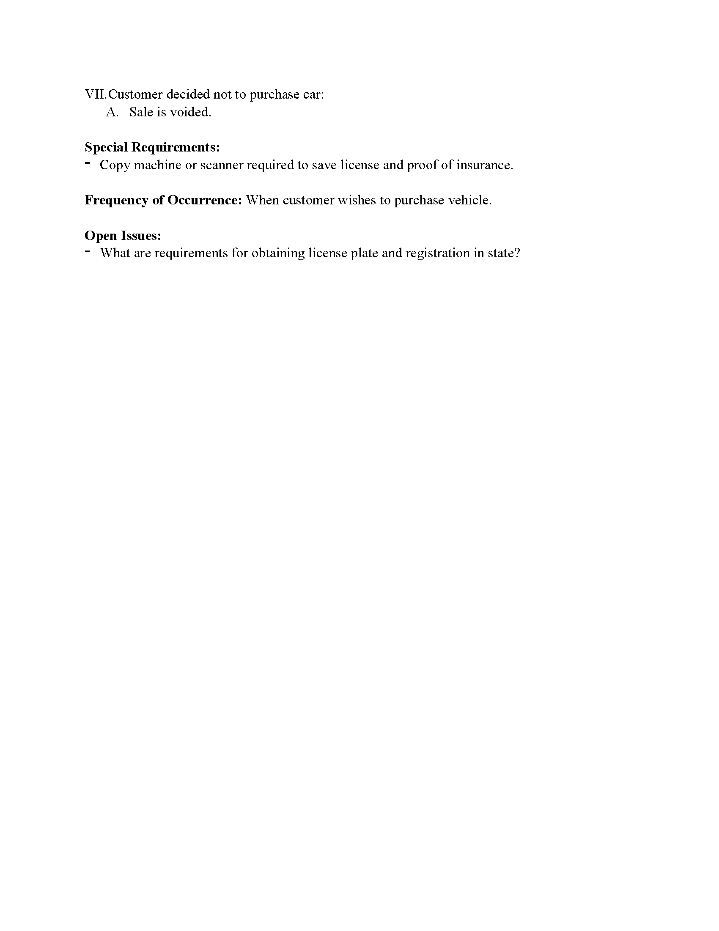
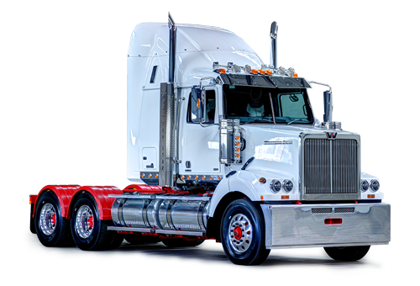


Slide 6

User is extended by
Subcontractor
Representative
Admin
One admin services zero or many receipts
Customer
A rep and an Admin have a Payroll
A catalog contains cars
An admin updates and services the catalog
A company rep will update the cars info

Slide 7
This list is not exhaustive. As with everything this list will grow and evolve as the software itself evolves.

Slide 8
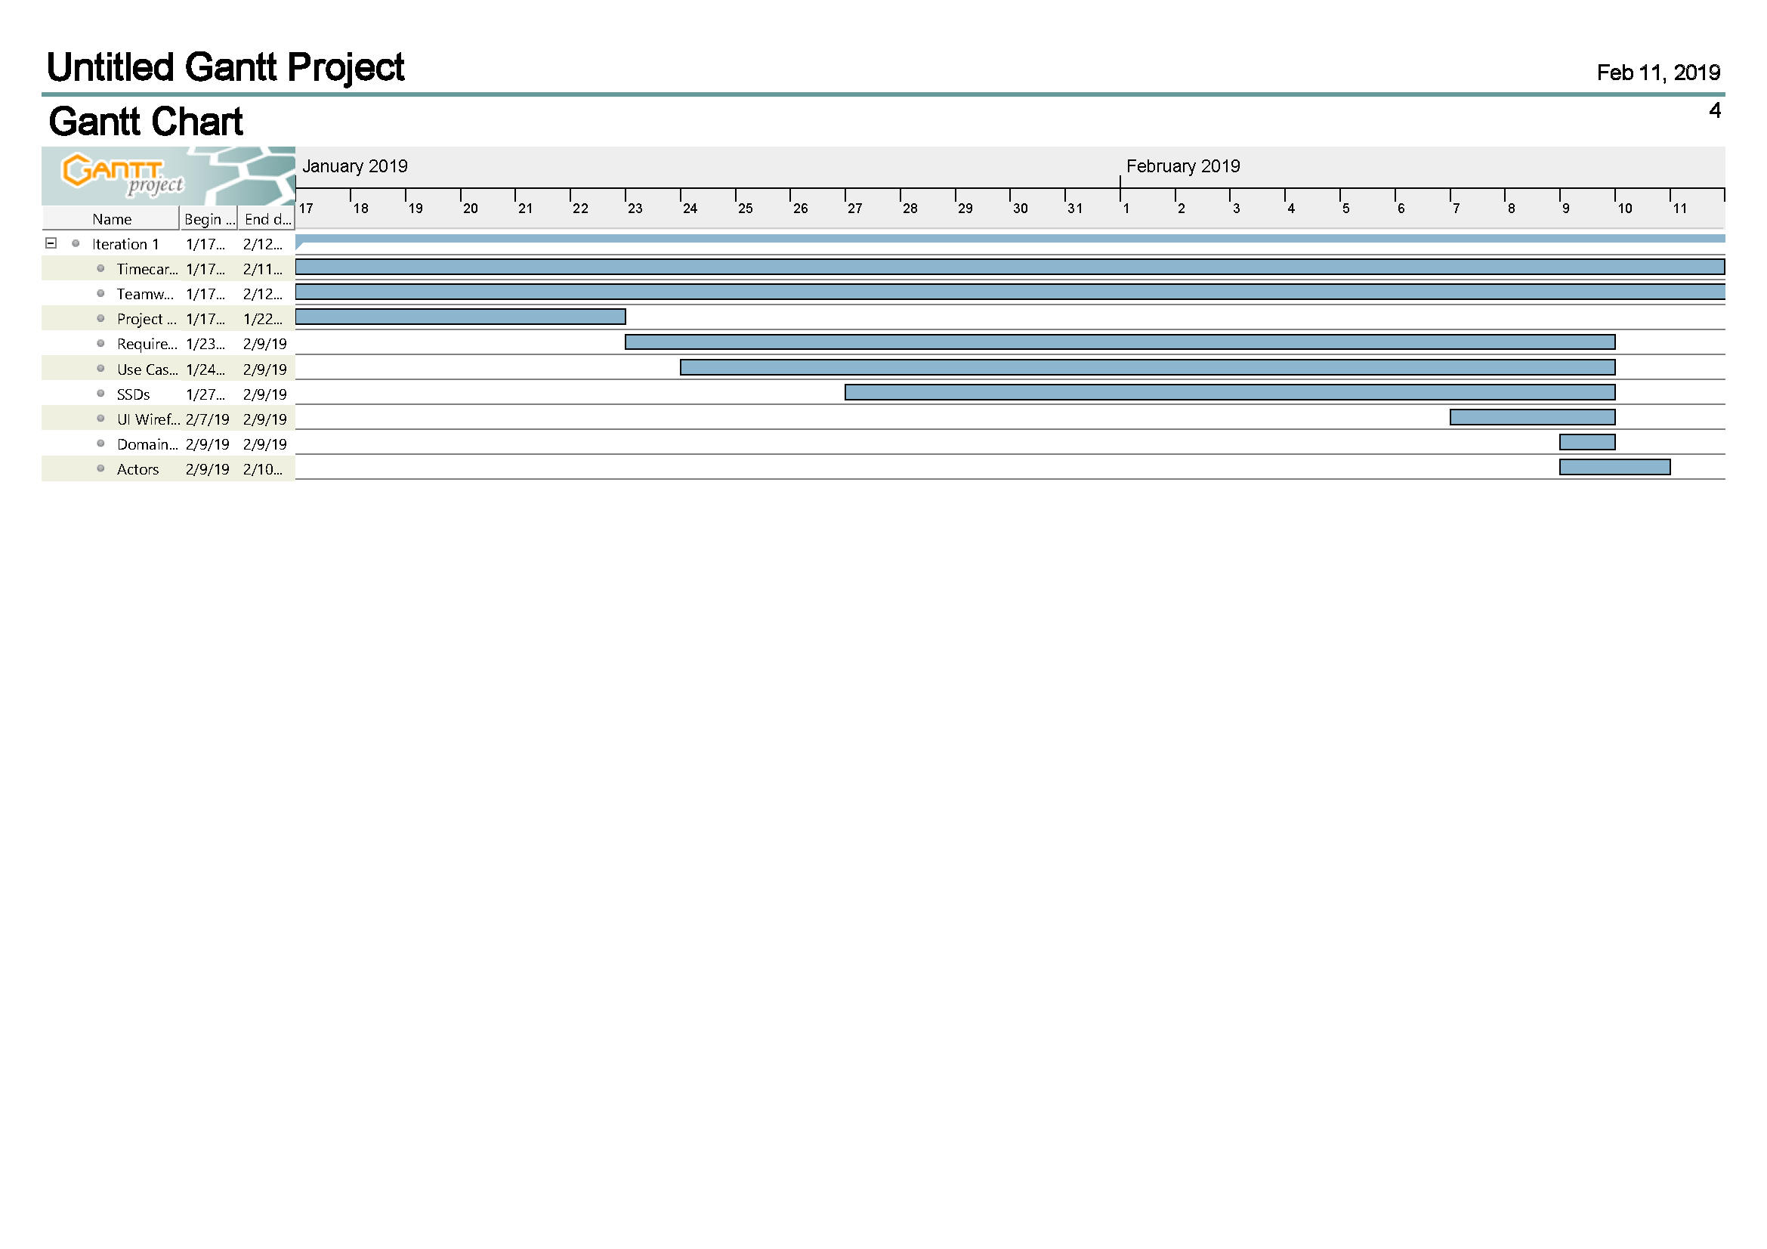
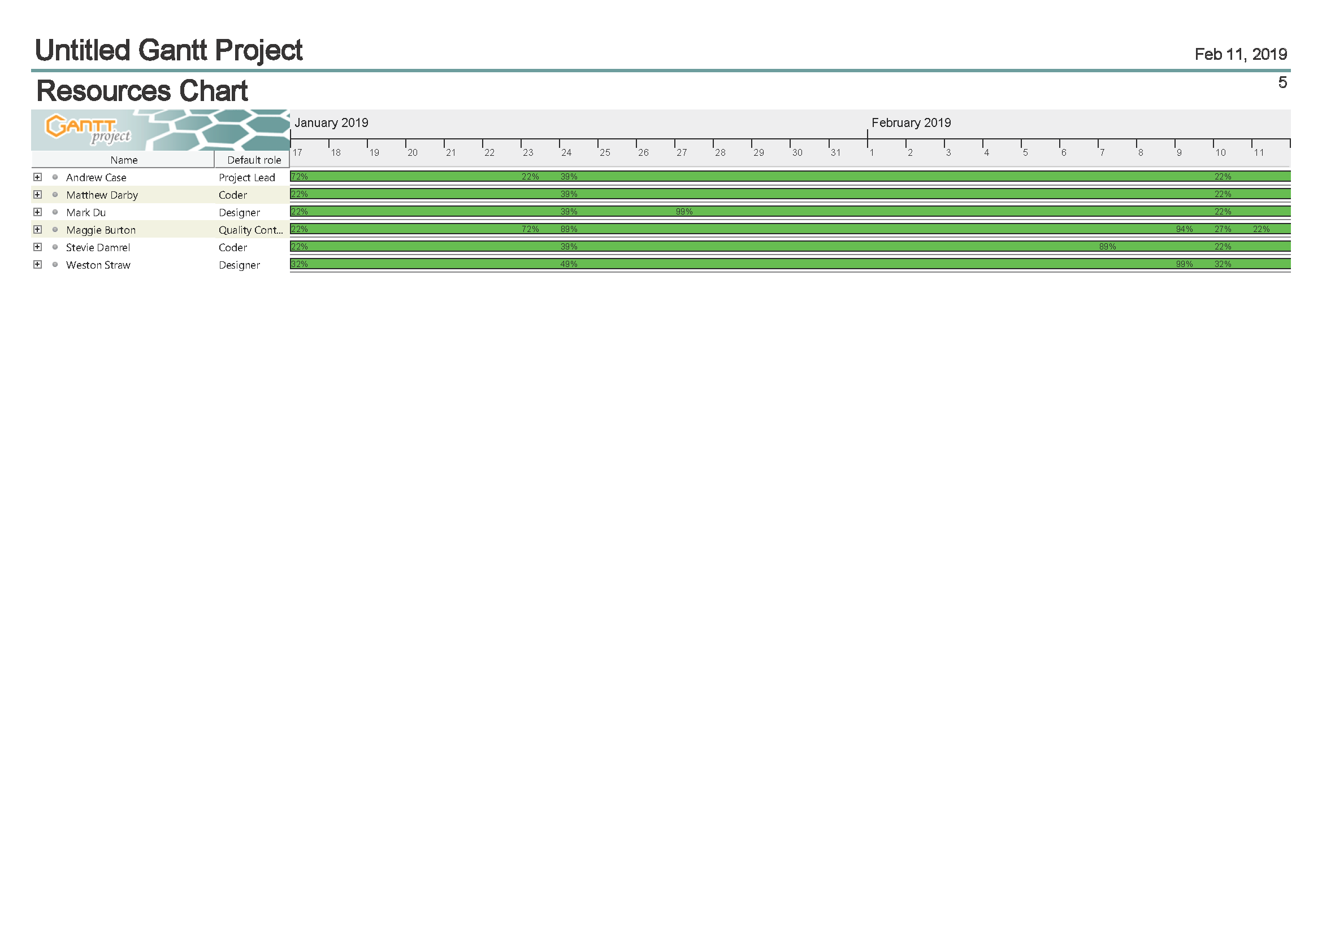

Slide 9
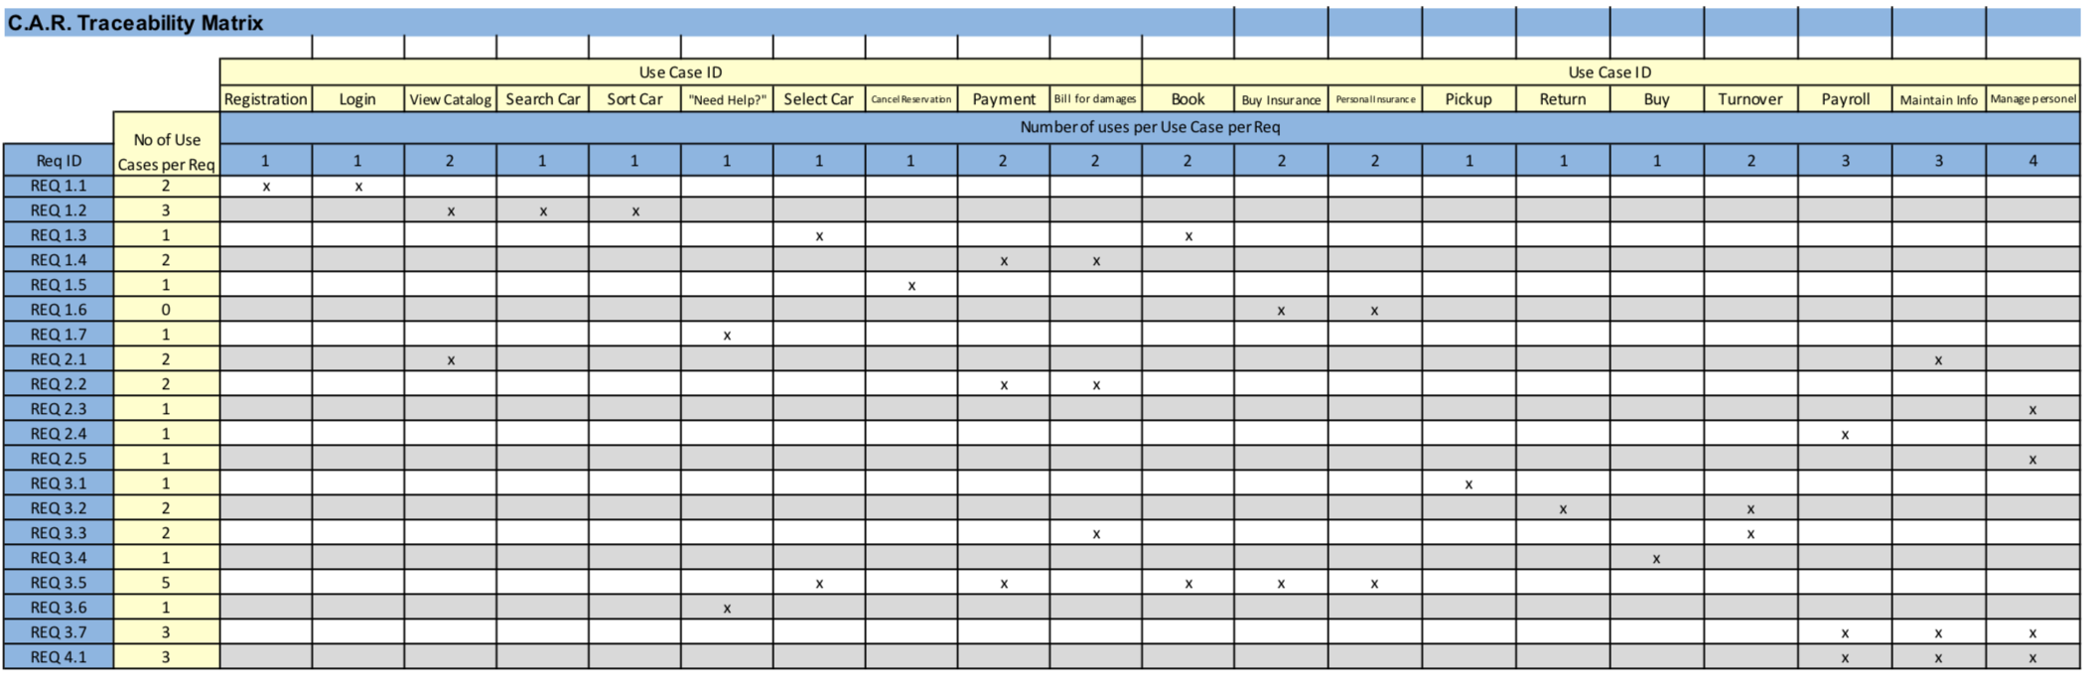

Slide 10
